Slide 1
Priority & Emerging Sectors, In-Demand Jobs, and the Future of Work

Slide 2
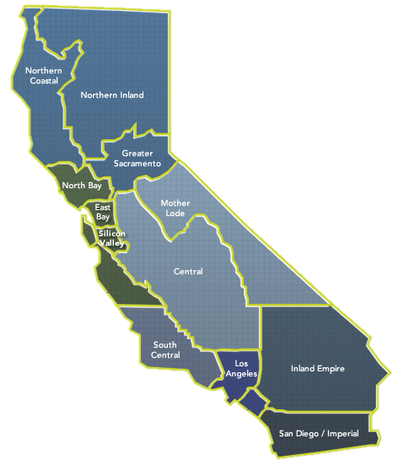
WHO WE ARE
The Centers of Excellence for Labor Market Research (COE) are the number one source for labor market information for the California Community Colleges.

Slide 3
UNDERSTANDING YOUR FUTURE
Understanding the Labor (Job) Market
Learn about Careers

Slide 4
JOBS IN SAN DIEGO COUNTY
Total Number of Jobs in San Diego County
1,803,104
1,733,010
Notes:
.

Slide 5





PRIORITY & EMERGING SECTORS
Advanced Manufacturing
Advanced Transportation
Agriculture, Water & Environmental Technologies
Business & Entrepreneurship
Education & Human Development
Energy, Construction & Utilities
Global Trade
Health
Agriculture, Water & Environmental Technologies
Information & Communication Technologies (ICT) and Digital Media
Life Sciences & Biotechnology
https://myworkforceconnection.org/sectors-overview/

Slide 6
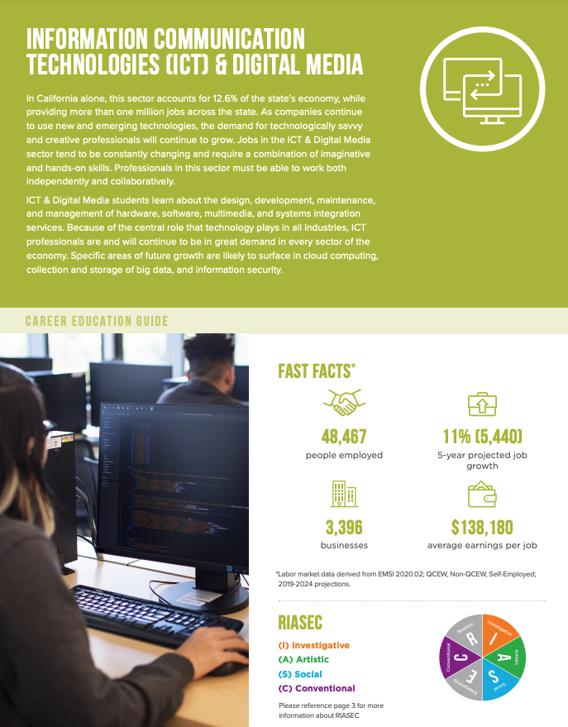
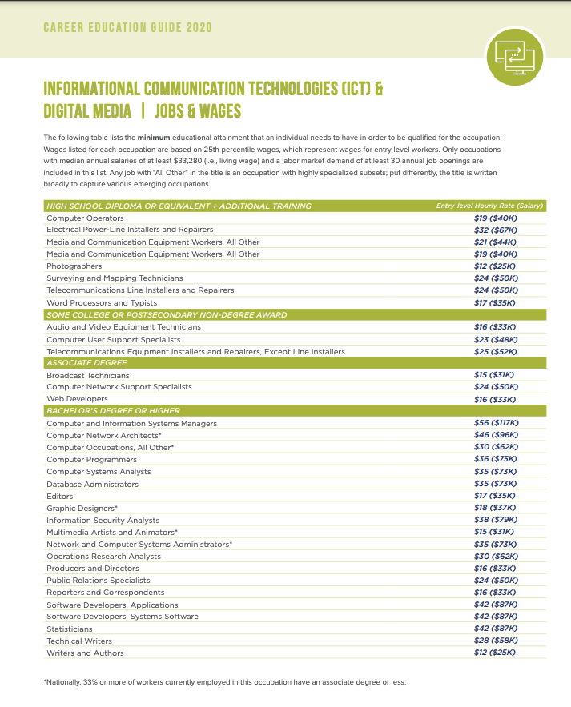
GET TO KNOW THE SECTORS
https://myworkforceconnection.org/sectors-overview/

Slide 7
IN-DEMAND JOBS
INFORMATION COMMUNICATION TECHNOLOGIES & DIGITAL MEDIA
San Diego County
Top Jobs (A.A./A.S. or B.A./B.S.)
Occupational Title | Average Annual Job Openings (2020-2025) | Entry-Level Earnings
Software Developers and Software Quality Assurance Analysts and Testers | 1,908 | $43.69
Computer Occupations, All Other | 706 | $31.20
Computer Systems Analysts | 583 | $33.52
Computer and Information Systems Managers | 548 | $60.92
Computer User Support Specialists | 454 | $21.90
Network and Computer Systems Administrators | 226 | $36.16
Public Relations Specialists | 219 | $22.96
Web Developers and Digital Interface Designers | 179 | $20.11
48,467
JOBS
11%
GROWTH (2019-2024)
Notes:
EMSI 2021.01

Slide 8
IN-DEMAND JOBS
HEALTH
San Diego County
Top Jobs (A.A./A.S. or B.A./B.S.)
Occupational Title | Average Annual Job Openings (2020-2025) | Entry-Level Earnings
Registered Nurses | 1,727 | $41.17
Clinical Laboratory Technologists and Technicians | 224 | $18.01
Social and Community Service Managers | 206 | $27.44
Physical Therapist Assistants | 143 | $40.75
Radiologic Technologists and Technicians | 124 | $57.78
Dental Hygienists | 118 | $43.83
Respiratory Therapists | 94 | $33.56
Occupational Therapy Assistants | 75 | $23.81
140,788
JOBS
13%
GROWTH (2019-2024)
Notes:
EMSI 2021.01

Slide 9
MIDDLE-SKILL JOBS ARE GROWING
Middle-skill jobs require more than a high school diploma but less than a four-year degree.
San Diego County, 2019
Top Middle Skill Jobs (A.S.), 2020-2025
Occupational Title | Average Annual Job Openings (2020-2025) | Typical Entry-Level Education | Work Experience Required | Entry-Level Earnings
Paralegals and Legal Assistants | 346 | Associate degree | None | $25.54
Electrical and Electronic Engineering Technologists and Technicians | 276 | Associate degree | None | $26.38
Veterinary Technologists and Technicians | 156 | Associate degree | None | $17.87
Physical Therapist Assistants | 143 | Associate degree | None | $23.82
Human Resources Assistants, Except Payroll and Timekeeping | 142 | Associate degree | None | $18.29
Architectural and Civil Drafters | 141 | Associate degree | None | $26.50
Radiologic Technologists and Technicians | 124 | Associate degree | None | $28.30
Avionics Technicians | 91 | Associate degree | None | $29.56
1.7 M
JOBS
38 %
MIDDLE SKILL JOBS
Notes:
EMSI 2020.04

Slide 10
WHO IS HIRING
MOST ONLINE JOB POSTINGS
EMPLOYER | RANKED
University Of California | 1
Scripps Health | 2
General Atomics | 3
Marriott International Inc. | 4
Sharp Healthcare | 5
Northrop Grumman | 6
Qualcomm | 7
Anthem Blue Cross | 8
TOP EMPOYERS
Notes:
Burningglass 2018-2020, San Diego County

Slide 11
FUTURE OF WORK
EMPLOYERS ARE EMPHASIZING SKILLS
SOFT SKILL | NUMBER OF ONLINE JOB POSTINGS
Communication Skills | 465,753
Teamwork / Collaboration | 229,278
Organizational Skills | 218,438
Detail-Oriented | 191,638
Physical Abilities | 166,669
Written Communication | 113,308
Multi-Tasking | 111,362
Building Effective Relationships | 98,282
1.3 M
ONLINE JOB POSTINGS
Notes:
Burningglass 2018-2020, San Diego County

Slide 12
UNDERSTANDING YOUR FUTURE
Understanding the Labor (Job) Market
Learn about Careers

Slide 13
Career Development Continuum
BEGIN EARLY
Self Awareness
Career Awareness
Career Exploration
Career Preparation
Career Prep: Practicum and Internships
Career Training

Slide 14
Links
RESOURCES
Career Coach: www.workforce.emsicc.com
Learning About Careers: www.careered.org
Finding a Community College & Program:
https://careered.org/college-program-finder/
Career Education Guide:
https://myworkforceconnection.org/

