Slide 1
Eastlake High School

Slide 2
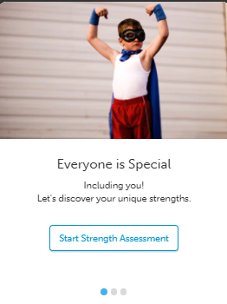
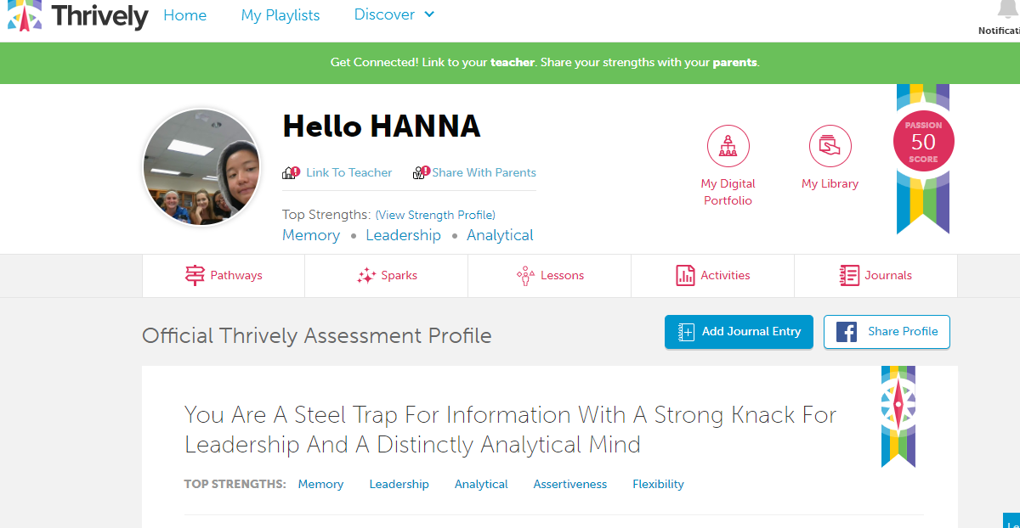
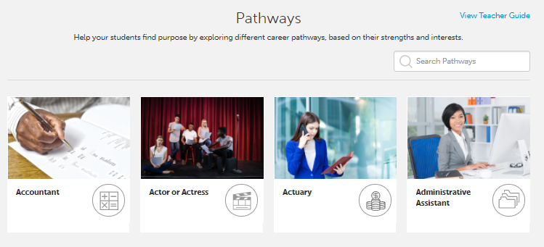
Thrively Grades 9-11
Created student account. Encouraged them to share their strengths and interests with parents/guardians.
Chose interests
Chose top 3 potential careers
Completed strength assessment
Explored top 5 strengths
Explored potential careers
Browsed through suggested activities
Met with counselor to review

Slide 3
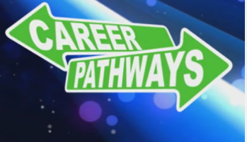
9th Grade
FALL SEMESTER
Lesson: Exploring Career Pathways
Focus: Follow interests related to their career aspirations and pathways.
Video: Get a jump on your careers?
Activity: Explore different pathways/careers.
Journal Entry: Reflect on what you learned after watching a career video. Why did you choose to watch this video? What three things will you take away from it?
SPRING SEMESTER:
Lesson- Free to Be Me
What do you want the world to know about you? Who are you?
Focus: Self-Awareness
Video: My Truth. “I know where I'm going and I know the truth, and I don't have to be what you want me to be. I'm free to be what I want.” (Muhammad Ali) Ali was one of the most influential and successful athletes of all time. During his lifetime he was deeply affected by racism and other injustices, which made him even more determined to control his own life.
Journal Entry: Who are you? When do you feel you are the greatest? What should the world know about you? What do you want to accomplish in high school?

Slide 4
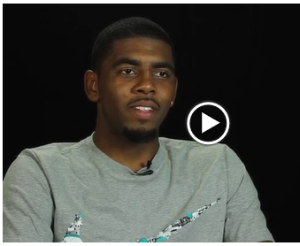
10th Grade
FALL SEMESTER
Lesson: Exploring Career Pathways
Focus: Follow interests related to their career aspirations and pathways.
Video: Get a jump on your careers?
Activity: Explore different pathways/careers.
Journal Entry: Reflect on what you learned after watching a career video. Why did you choose to watch this video? What three things will you take away from it?
SPRING SEMESTER:
Lesson: GRIT- a positive trait based on passion, perseverance, and motivation.
Focus: Persistence, passion, success
How do you become an expert in something? What is the secret to success? It is not what you were born with or where you come from. It is YOUR persistence and determination to put 10,000 hours into your passion.
Video: 10,000 hours featuring Kyrie Irving
Journal Entry: Is there something you are passionate about where you can put in 10,000 hours? Do you believe you can be successful if you put in the effort? What is something you could put more effort into? What is one goal you can work towards and what do you need to do to accomplish that goal?

Slide 5
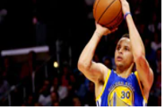
11th Grade
FALL SEMESTER
Lesson: Exploring Career Pathways
Focus: Follow interests related to their career aspirations and pathways.
Video: Get a jump on your careers?
Activity: Explore different pathways/careers.
Journal Entry: Reflect on what you learned after watching a career video. Why did you choose to watch this video? What three things will you take away from it?
SPRING SEMSTER
Lesson: Success Is Not An Accident
Focus: Grit, Focus, Effort
Video: How did Stephen Curry become the MVP of the NBA?
Journal Entry: What is one goal or dream that you have for your future? Describe the work habits and character traits that you will need to show in order to make your dreams come true.

Slide 6
What’s Next?
Students continue to explore potential career paths with videos and relevant activities.
Students continue to review the activities based on their individual strengths and interests.
Students share their potential career paths and activities you can participate in with your counselor.
Students attend presentations led by various career speakers.

